Slide 1
Attica Islands Network of Municipalities
Local Program CLLD/LEADER: «Nature & Culture “On Board”
”INTERTERRITORIAL & TRANSNATIONAL PROGRAM
«Blue Growth Incubators Network»

Slide 2
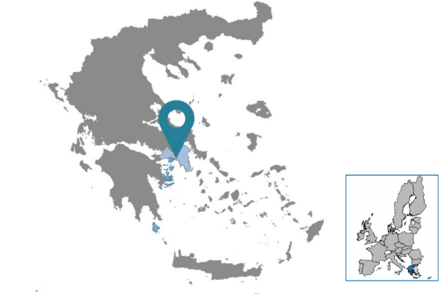
About Our Company
Our company consist of the CLLD/LEADER and our Technical Support. Its purpose is social and developmental and in no case it is considered as profit / commercial.
It has become a LAG and a FLAG and another purpose of the Company is to develop international networking partnerships for integrated rural and urban development.
8
Municipalities
10
Social actors
1
Development SA organization
13.000.000 €
+
21.000.000 €

Slide 3
The inspiration
PARNONAS SA:
The main players in the maritime field:
Fishermen
Aquaculture
Tourism
At 2016 the main motivation: The realization that around area of Parnonas, were aquaculture is developed, there were no companies to support supplies, feed and other supplements, or even training for people who could work in the enterprises.

Slide 4
The obstacle
Create an incubator in Parnonas, supporting productive maritime sectors
Fisheries and Aquaculture
Two main sectors with their strengthens and weaknesses
Fishermen: Sector shrinking day by day
Aquaculture: Sector that despite the fact of functioning for over 40 years, is treated with incredulity by the local community.

Slide 5
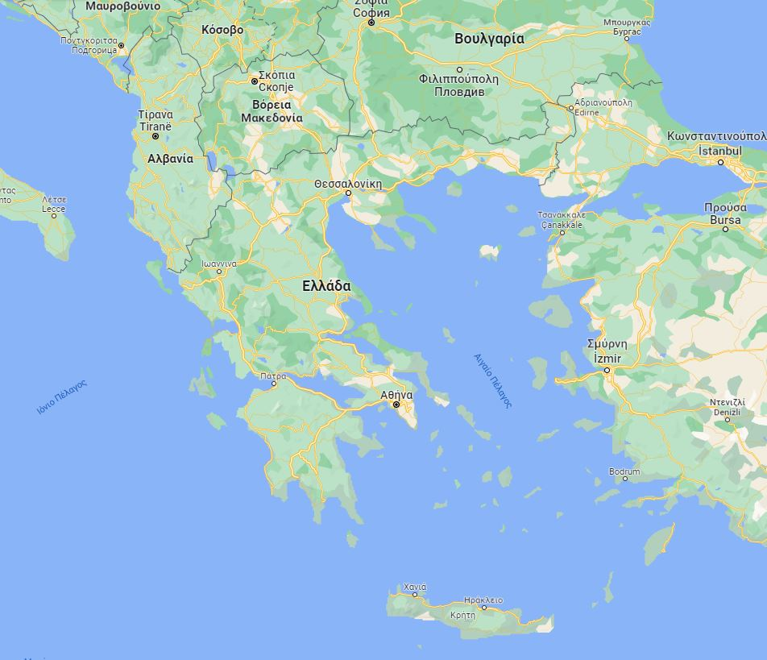
The idea
2019: Participating in CAP Strategies Planning, at Brussels, we had the chance to discuss with other FLAGS and decide to open again the file of Incubator.
The Network Incubator was the idea that at the beginning concerned every FLAG participated on this project.
Due to COVID period we organize all the preparatory phase,
On November 2021 we apply the financing of our Project.

Slide 6
The Actions
The Project consists of 2 distinct Phases:
Preparatory Phase
Main Phase
In the Preparatory Phase, all the necessary actions were taken to find partners who would meet the conditions set by the invitation.
The Main Phase of the Plan concerns the implementation, which is divided into the implementation of:
Joint Actions
Local Actions
9.020,00 €
41.880,00 €
Preparatory phase
Coordination - Project management
69.850,00 €
151.250,00 €
Awareness - Publicity
Blue Growth Incubator Network: Consulting and Experts

Slide 7
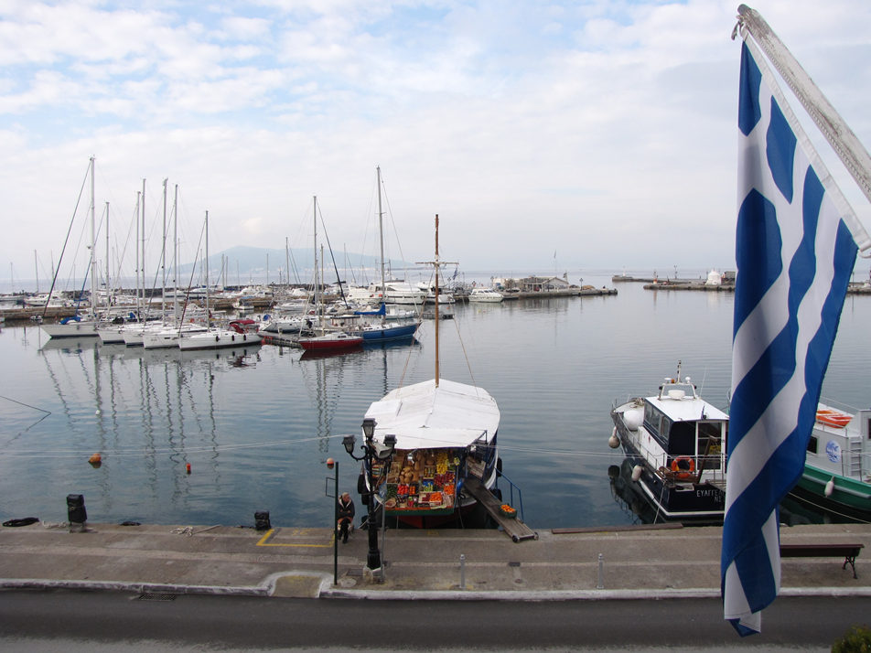
BLUE GROWTH NETWORK INCUBATORS
Transnational Cooperation Project
Blue Growth: EU 's long - term strategy to support sustainable development
Sustainable jobs
Knowledge | Safety
Personalized measures

Slide 8
Collaborators
7 Greek | 1 Bulgarian
Coordinating Partner - Attica Islands Network

Slide 9
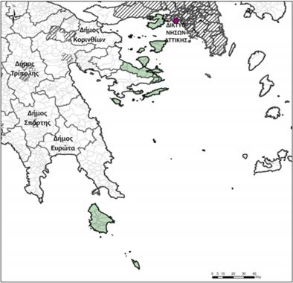
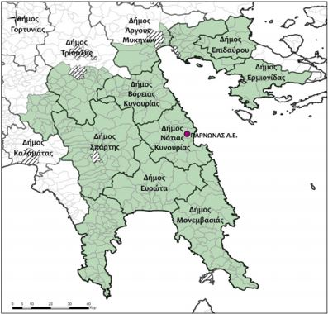
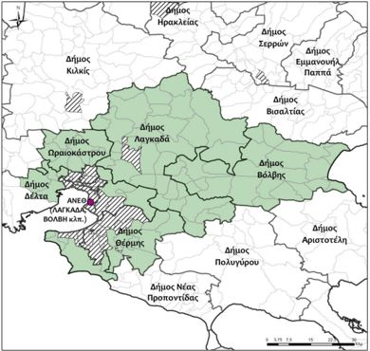
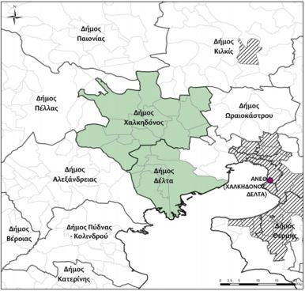
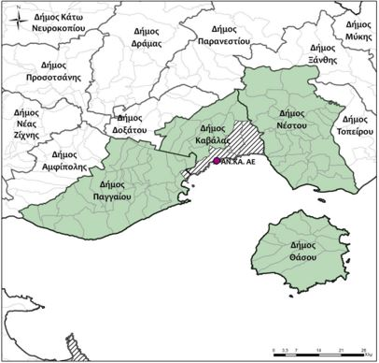
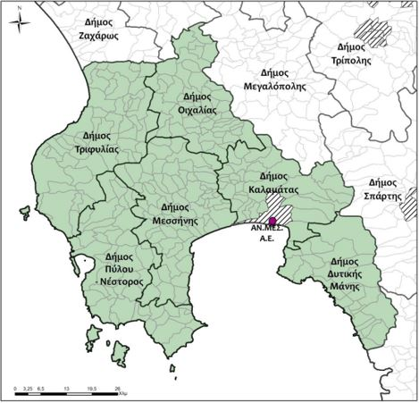
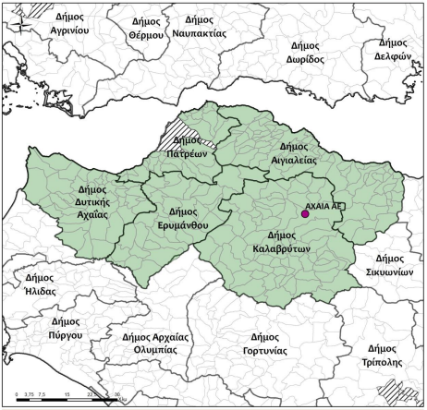
Collaborators
7 Greek | 1 Bulgarian

Slide 10
Purpose
The creation of an Incubator Network, which will work together to address selected marine challenges in order to support:
The protection and restoration of aquatic biodiversity | strengthening marine and coastal ecosystems
Enhancing technological development
The development of vocational training
Enhancing the competitiveness and viability of maritime and shipping companies

Slide 11
Main phase
Coordination
Road Map and strategic studies for blue actions in each area.
Studies to examine the climate changes
E- Port
Dissemination – Assessment
 | 7.352,00 €
 | 6.628,00 €
 | 4.000,00 €
 | 4.000,00 €
 | 7.900,00 €
 | 4.000,00 €
 | 2.000,00 €
 | 6.000,00 €
Coordination - Project management
The Coordination - Project management action of the main phase has two partial actions:
Joint actions provision of services
Local action consulting services

Slide 12
Main phase
 | 29.000,00 €
 | 30.000,00 €
 | 10.000,00 €
 | 10.000,00 €
 | 12.500,00 €
 | 36.500,00 €
 | 10.750,00 €
 | 12.500,00 €
Consulting and Experts
The Consulting and Experts
action of the main phase has 5 partial actions:
Creation of the Blue Growth Incubator Network
Strategic Plans for "Blue Growth“
Impacts of Climate Change on Coastal and Marine Ecosystems
Studies on the "smart port of the future“
Port infrastructure support applications

Slide 13
Main phase
Awareness - Publicity
 | 15.500,00 €
 | 12.500,00 €
 | 6.000,00 €
 | 6.000,00 €
 | 15.600,00 €
 | 3.500,00 €
 | 2.250,00 €
 | 8.500,00 €
The Awareness - Publicity
action of the main phase has 9 partial actions:
Publicity and dissemination of project results
Project website in 3 languages
Conference organized by the Coordinating Partner
Three (3) newsletter editions of the project
Transnational workshops for "Blue Growth“
5 workshops organized by the 5 Fisheries LAGs - 6 local reports of results and conclusions
1 joint version for conclusions and results.
Maritime Awareness Actions
Local press events by LAGs in their areas

Slide 14
Timetable
2022 - 2023
CLLD/LEADER TRANSNATIONAL COOPERATION PROJECT BLUE GROWTH INCUBATORS NETWORK | 2022 |  |  |  | 2023
ACTIONS | 1st | 2nd | 3rd | 4th | 1st | 2nd
Preparatory phase
Coordination - Project management
Joint actions provision of services for: a) setting common standards, specifications and methodology b) technical support
Local action consulting services - local coordination and implementation
Blue Growth Incubator Network: Consulting and Experts
Creation of the Blue Growth Incubator Network
Strategic Plans for "Blue Growth"
Operational Study on the Impacts of Climate Change on Coastal and Marine Ecosystems in the Six (6) GPA Participating Areas.
Studies on the "smart port of the future"
Port infrastructure support applications
CLLD/LEADER TRANSNATIONAL COOPERATION PROJECT BLUE GROWTH INCUBATORS NETWORK | 2022 |  |  |  | 2023
ACTIONS | 1st | 2nd | 3rd | 4th | 1st | 2nd
Awareness - Publicity
Publicity and dissemination of project results
Project website in 3 languages
Conference organized by the Coordinating Partner - Attica Islands Network
Three (3) newsletter editions of the project
Transnational workshops for "Blue Growth"
5 workshops to be organized by the 5 Fisheries LAGs
1 joint version-transnational version for conclusions and results.
Maritime Awareness Actions
Local press events by LAGs in their areas

Slide 15
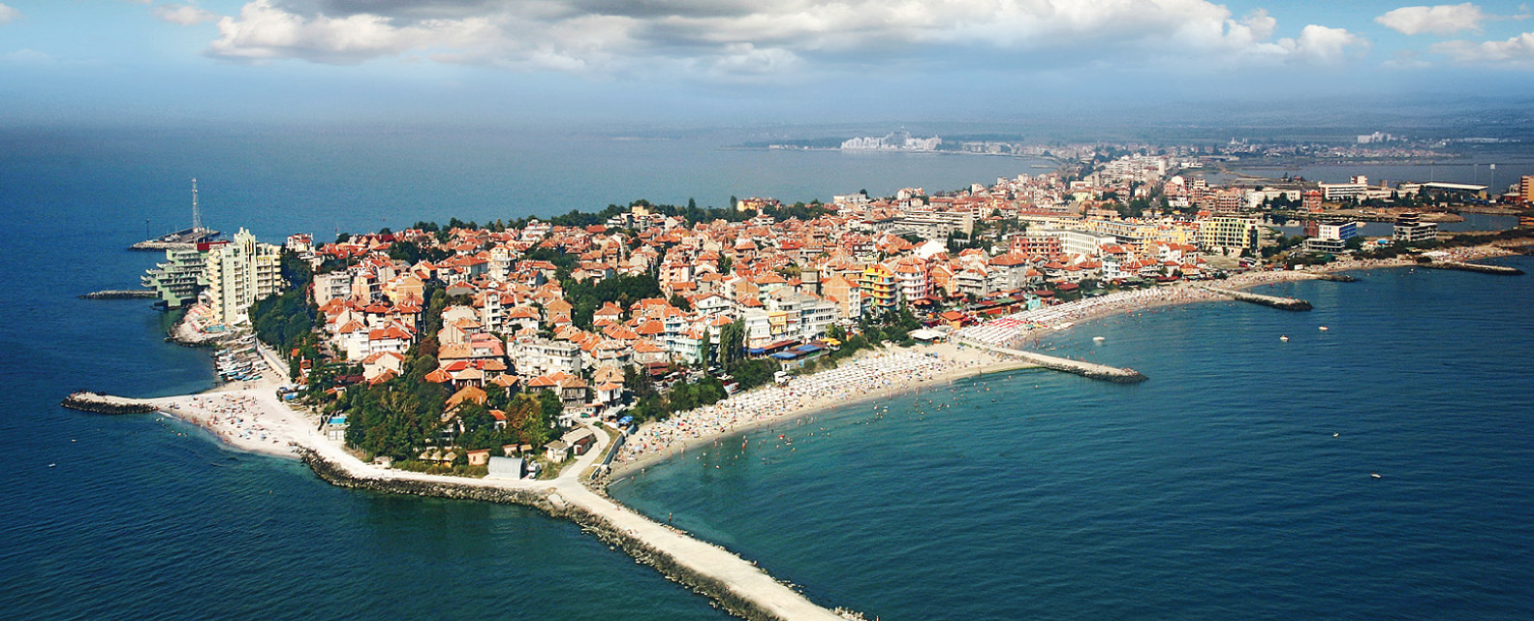
Current situation
Our Goal
Preparatory phase
Our goal is to create a tool that will guide new professions and activities as a result of blue growth and rather with the use of smart technologies.
Most likely with the creation of an online guide that will utilize and present the results obtained from the strategy studies, which are based on parameters, such as climate change and the road map, could create a possible business-environmental planning, on a ten-year vision.
Coordination - Project management
Consulting and Experts
In the stage of collaboration and exchange of knowledge we collaborated with the University of Piraeus and 5 graduate students with the aim of preparing studies for the analysis of each area and suggestions for improvement
2023
Awareness - Publicity

Slide 16
T H A N K Y O U
Attica Islands Network of Municipalities
«Blue Growth Incubators Network»

